Slide 1
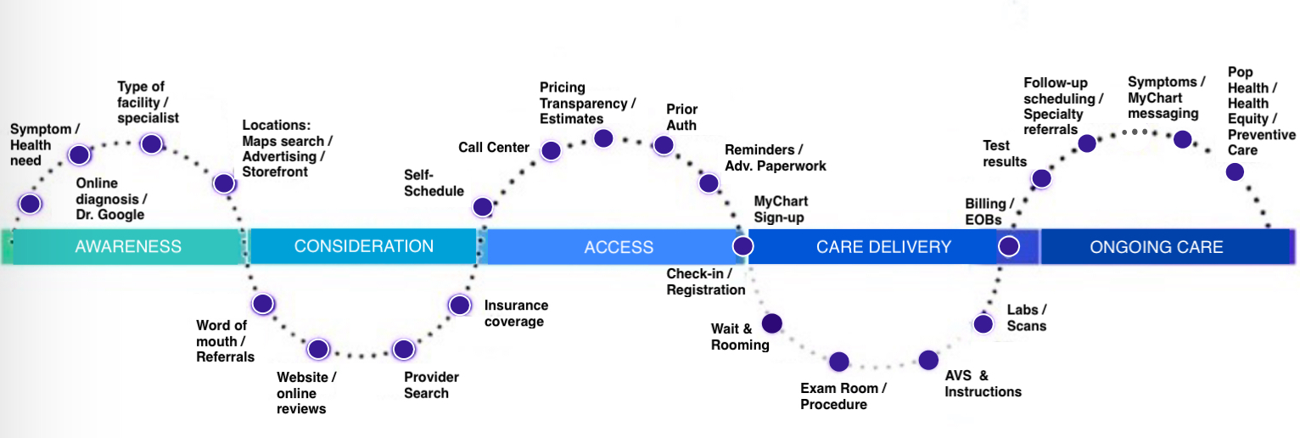
The patient journey

Slide 2
The patient journey
& pain points
What type of doc do I need?
What kind of facility/care should I go for?
Is it urgent?
Why some docs don’t schedule online?
How long will my wait be with this doc?
When is a prior auth needed?
Will this delay anything? What if denied?
Should I do anything?
Referral taking forever—lost?
How do I follow up & check?
I forgot to schedule PCP follow
OON referral—will it be covered? Med records sent?
Fear
Discomfort
Long wait time!
Not the doc I wanted
Is there a waitlist?
Can I get the care I need at this location?
Qs will prob be asked again
Directions/ parking unclear
How long for results?
No doc message.
Next steps needed?
Shocking cost
Confusing/what svc?
How do I check if right?
“Due now” too soon
How do I see notes my doctor took?
Follow-up Qs not as quick
What preventive care do I need?
What CPT should I look up?
Ins can’t tell me OOP cost
What extra risk factors do I have?
Looks scary?
But I don’t know where to start for answers
“How do I find the right doc?”
Ppwk has same Q’s as online
Electronic sig but no text/copy
Where do I go?
What labs will have my orders? Do I need paper?
Labs are closed/shorter hours
Online info on lab services not clear
I forget to get tested/need reminders
My plan isn’t listed
Listings out-of-date
What do I ask my insurance?
The popular/best docs aren’t taking new pts
Waiting
Asked name/DOB again
Does this doc have expertise I need?
Will I be in good hands?
Will I like the doc once I meet them?
What other docs will I be billed for?
Short appt time
Hard to follow everything doc said
I forgot to ask some questions
I didn’t notice/read
I need help with some of the steps
Did some things but forgot others
Can I trust these ratings?
Patients experience pain, confusion & frustration at literally every step in the patient journey.

